Slide 1
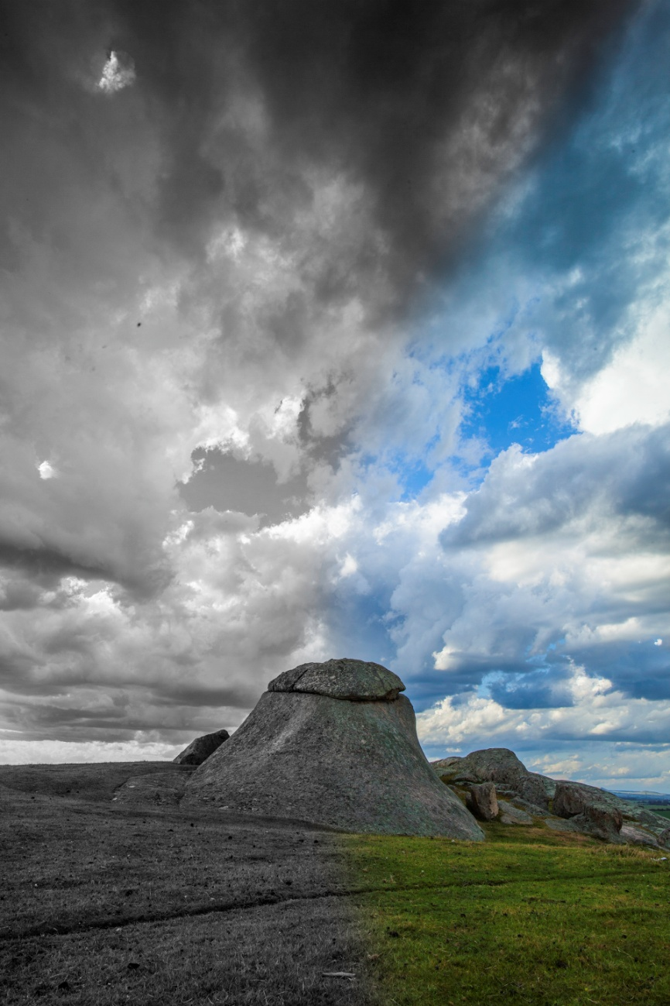
Black & White Demonstration
A Landscape
How can we ‘see’ better in black & white?
Pre-visualisation is the key
Research, read, review, critique
Understand the strengths of Black & White:
Light & shade, remove the distraction of colour
Emphasis on composition, structure, balance
Geometric shapes, patterns,
Textures
Keep searching for the Black & White strengths
Stay in the Black and White moment
The following example uses Light Room 5 and Photoshop CS6....

Slide 2
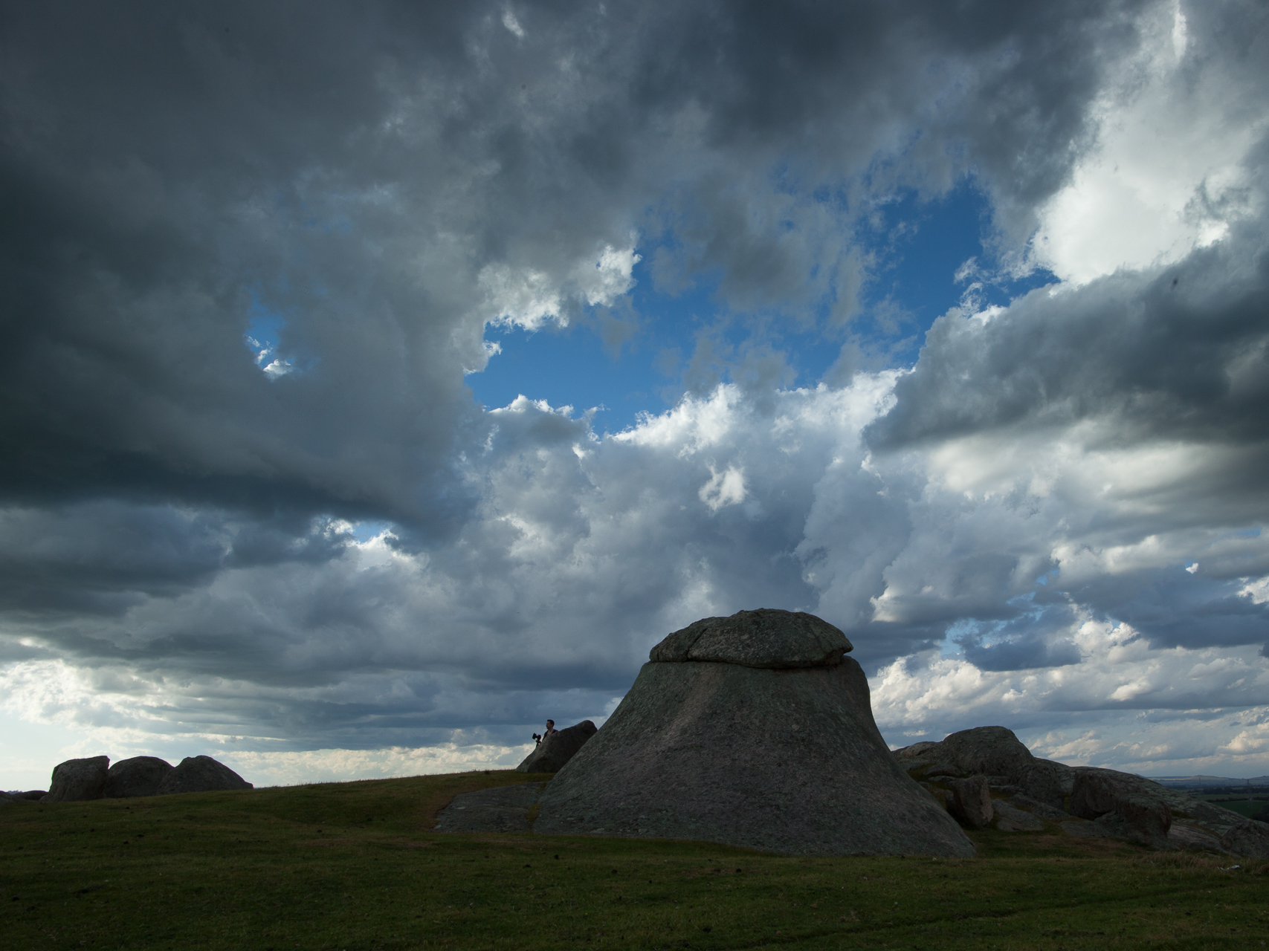
Original RAW file

Slide 3
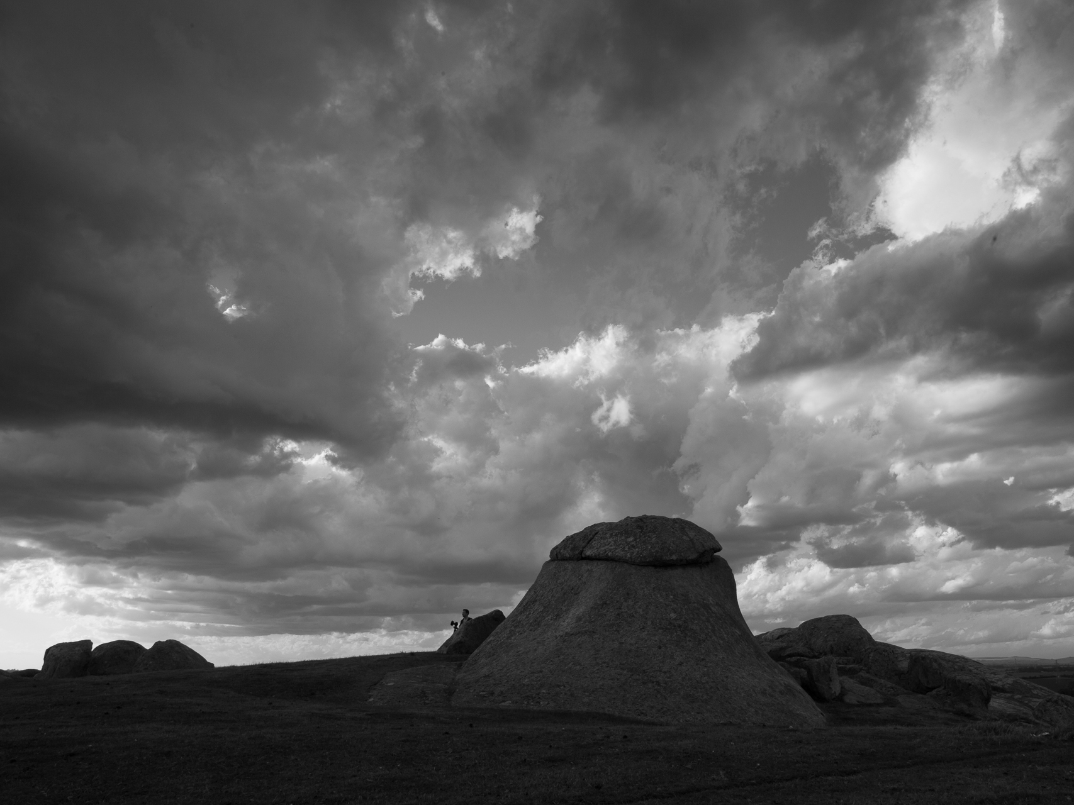
Pre-visualised darker blue sky areas
to contrast against clouds
These clouds
are bright
Central rock needs to be
lighter and stand out
Foreground grass is too dark
Straight B&W conversion (de-saturation)

Slide 4
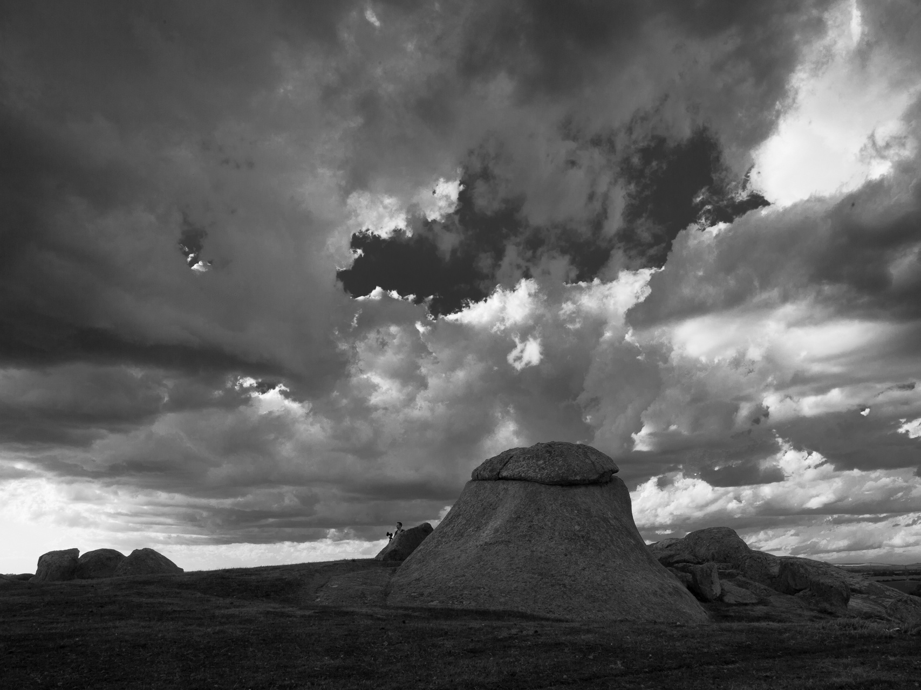
Decrease Blue via B&W Mix slider

Slide 5
Review histogram and make minor adjustments using sliders.
Balance histogram adjustments with what you like
Let’s darken
this area
... and lighten foreground
Adjust Exposure, Contrast & Clipping

Slide 6
Adjust Exposure, Contrast & Clipping

Slide 7
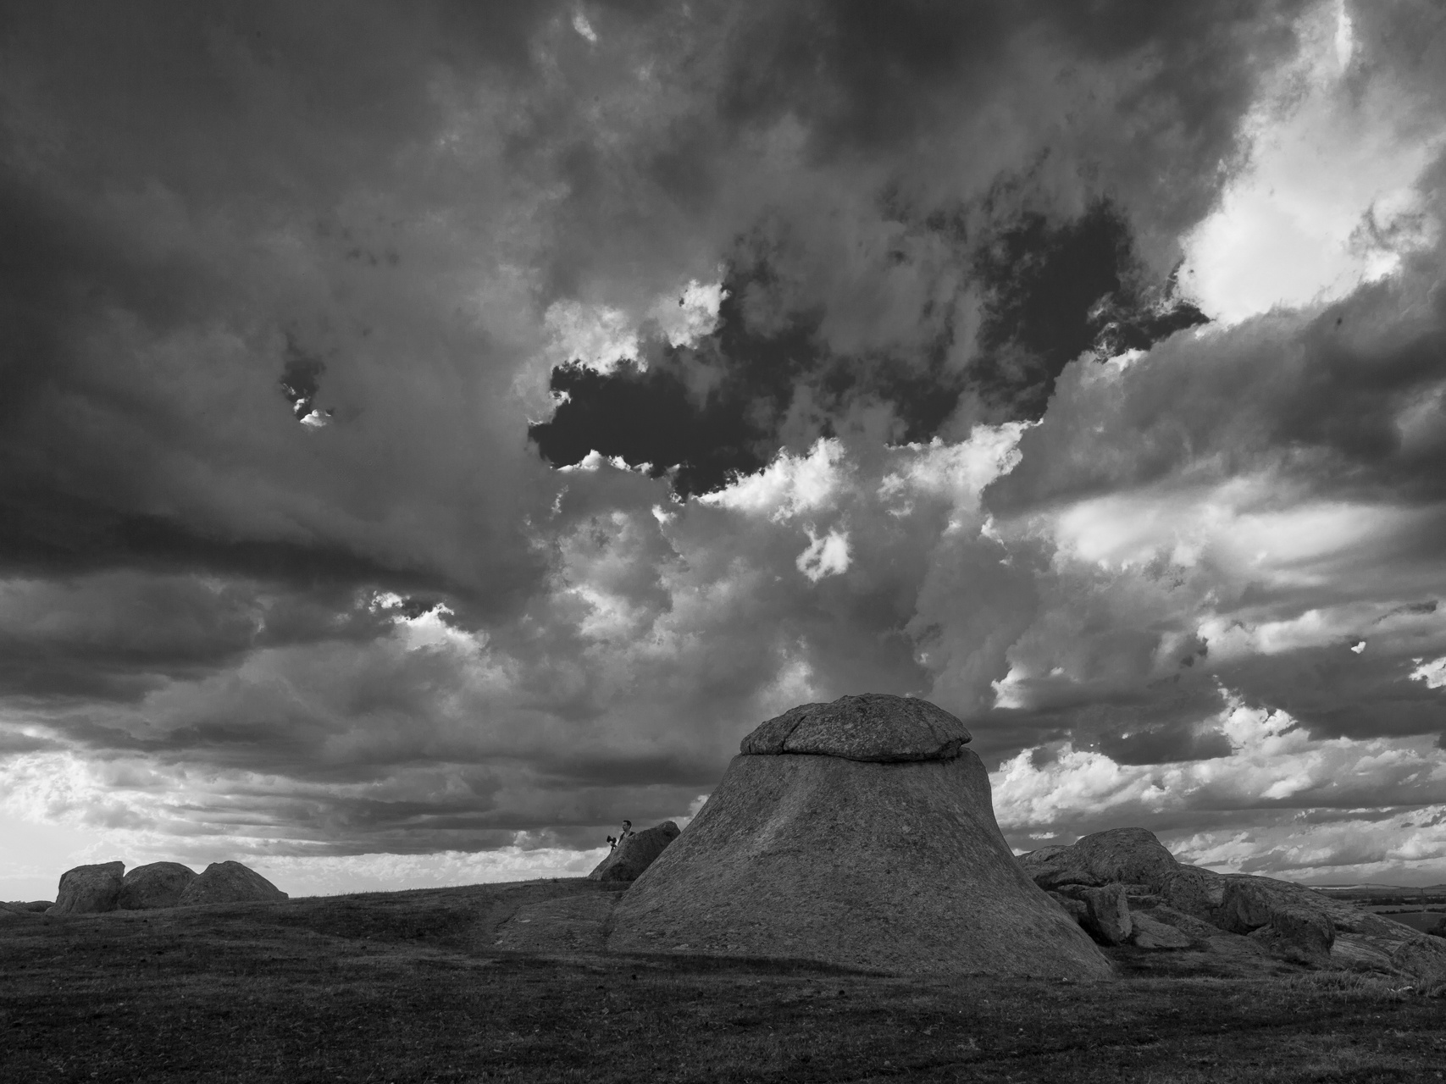
Darken highlights & lighten shadows

Slide 8
Increase ‘Clarity’

Slide 9
Blue sky is a little too dark
Darken greens via B&W Mixer slider

Slide 10
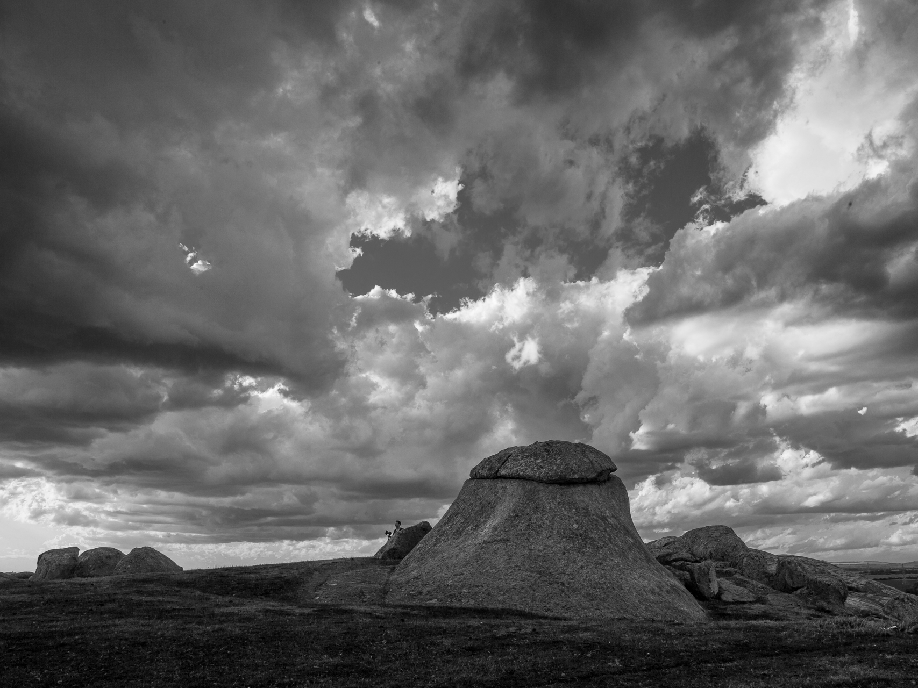
Lighten blue via B&W Mixer

Slide 11
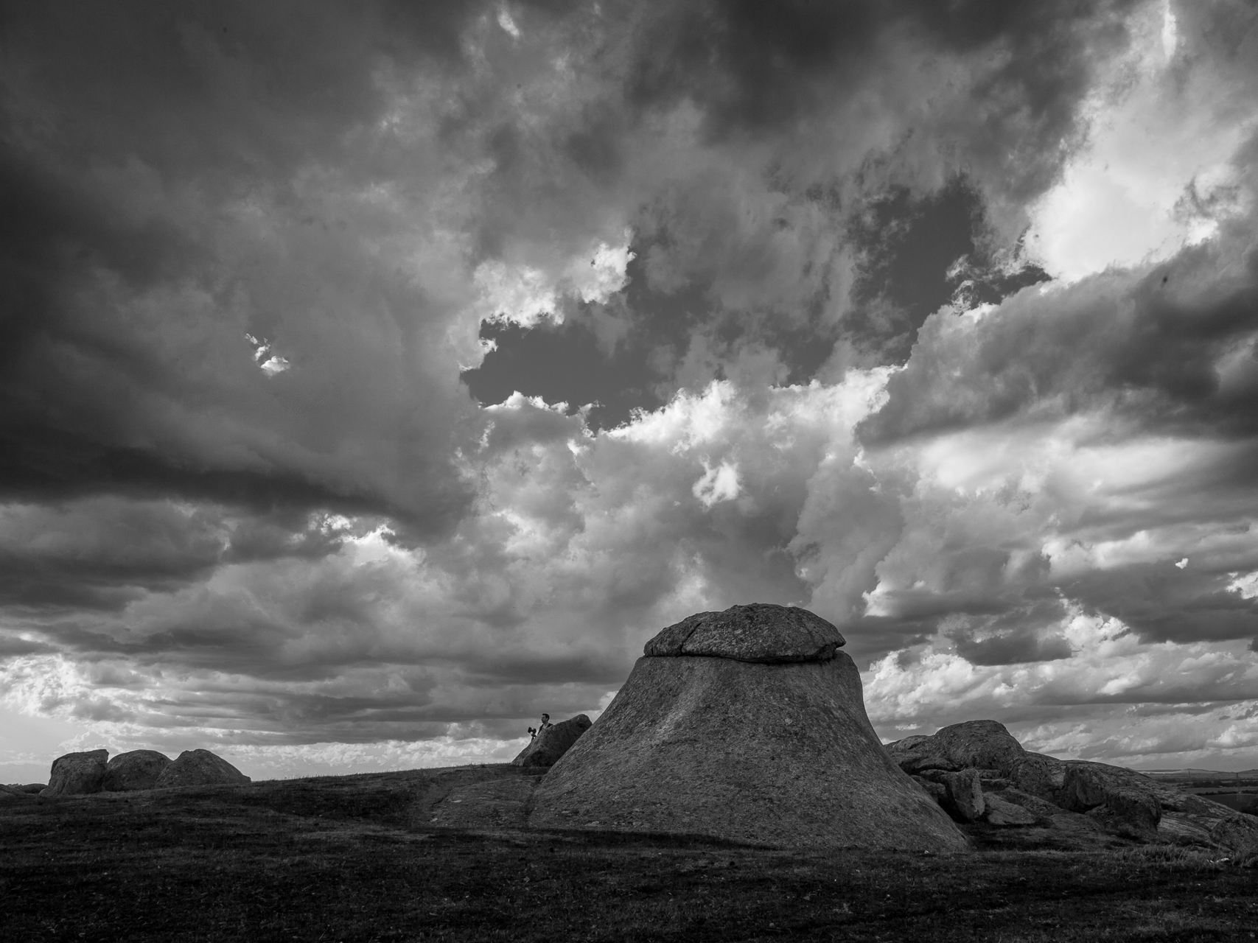
Vignette

Slide 12
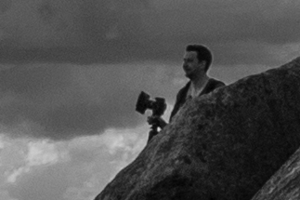
Option: Photoshop Clone Tool
Brushed in clouds, working from the left towards the rocks.
Remove the ambushing photographer

Slide 13
Remove the ambushing photographer

Slide 14
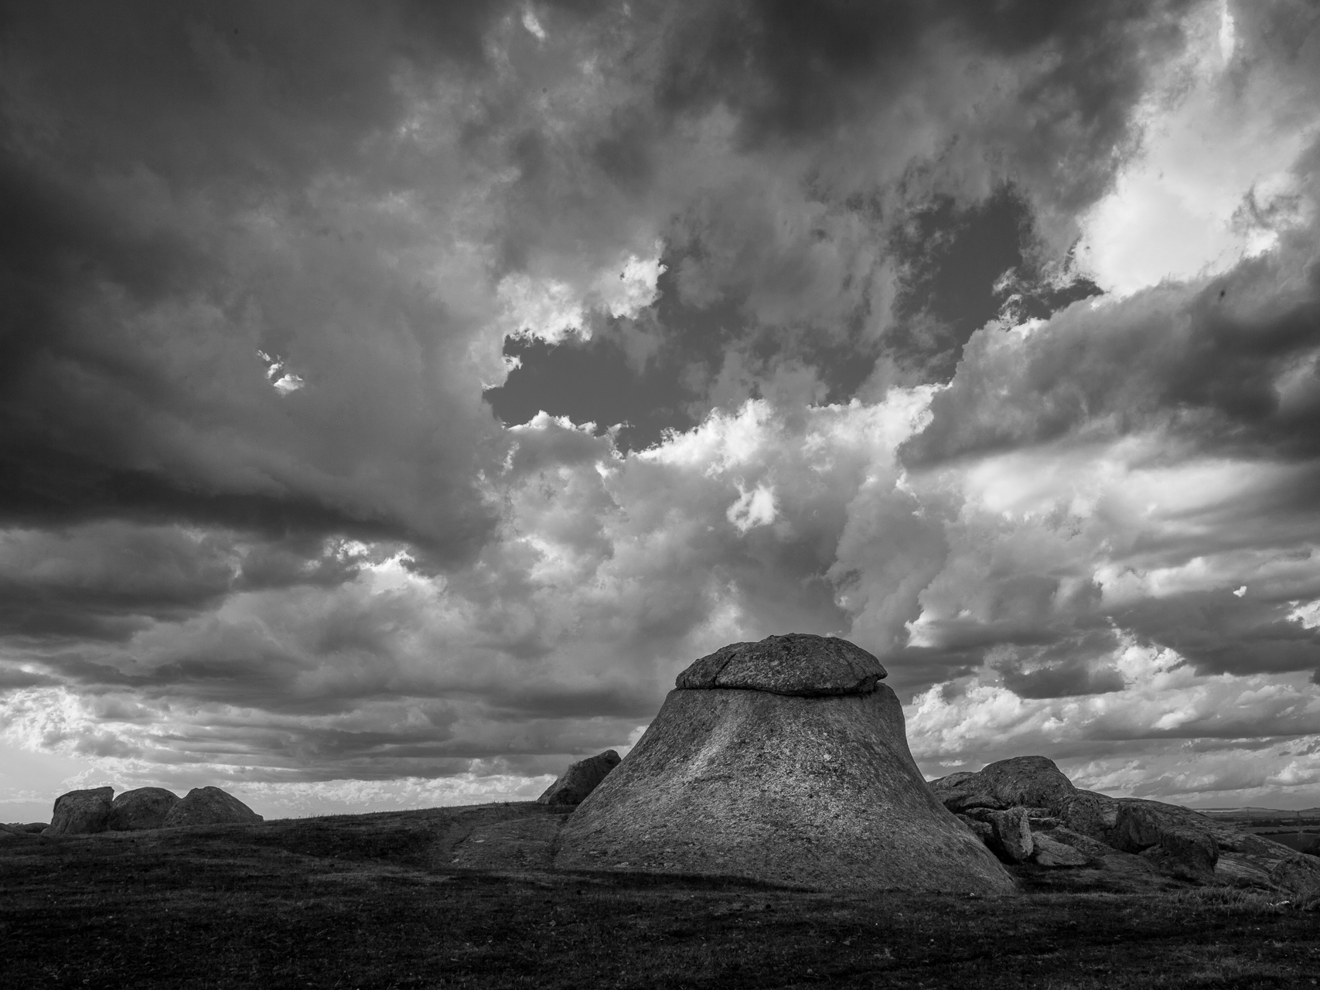
Dodged areas of rocks, for punch

Slide 15
Now print it

