Slide 1
Sale Camera Club
February 2023
Novice Class
Open Gippsland
Judge Bob Thomas

Slide 2
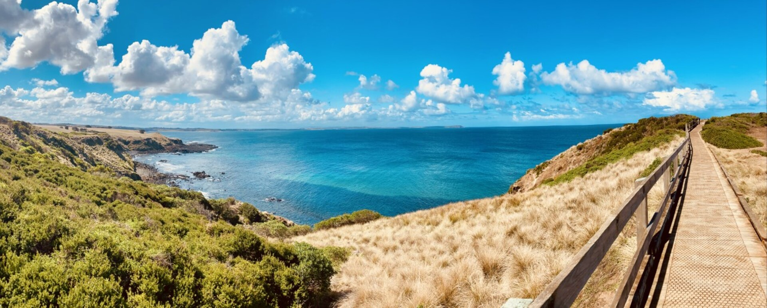
Panoramic Ocean
Hayley Furlong
Nicely framed panorama here with a useful pathway leading our eyes into the distance. The image is nicely balanced and has plenty of interest. The horizon has a bit of an issue with curvature and this should be remediated with a bit of post processing so that it is dead straight with no deviation. There are various ways of approaching that, some more effective than others. Personally, I’d just copy a rectangular section of sea and paste it over the existing horizon to give a sharp, straight horizon – but there are various ways of achieving the same thing.
Open Gippsland-Novice-148-Panoramic Ocean.jpg
10 / 15

Slide 3
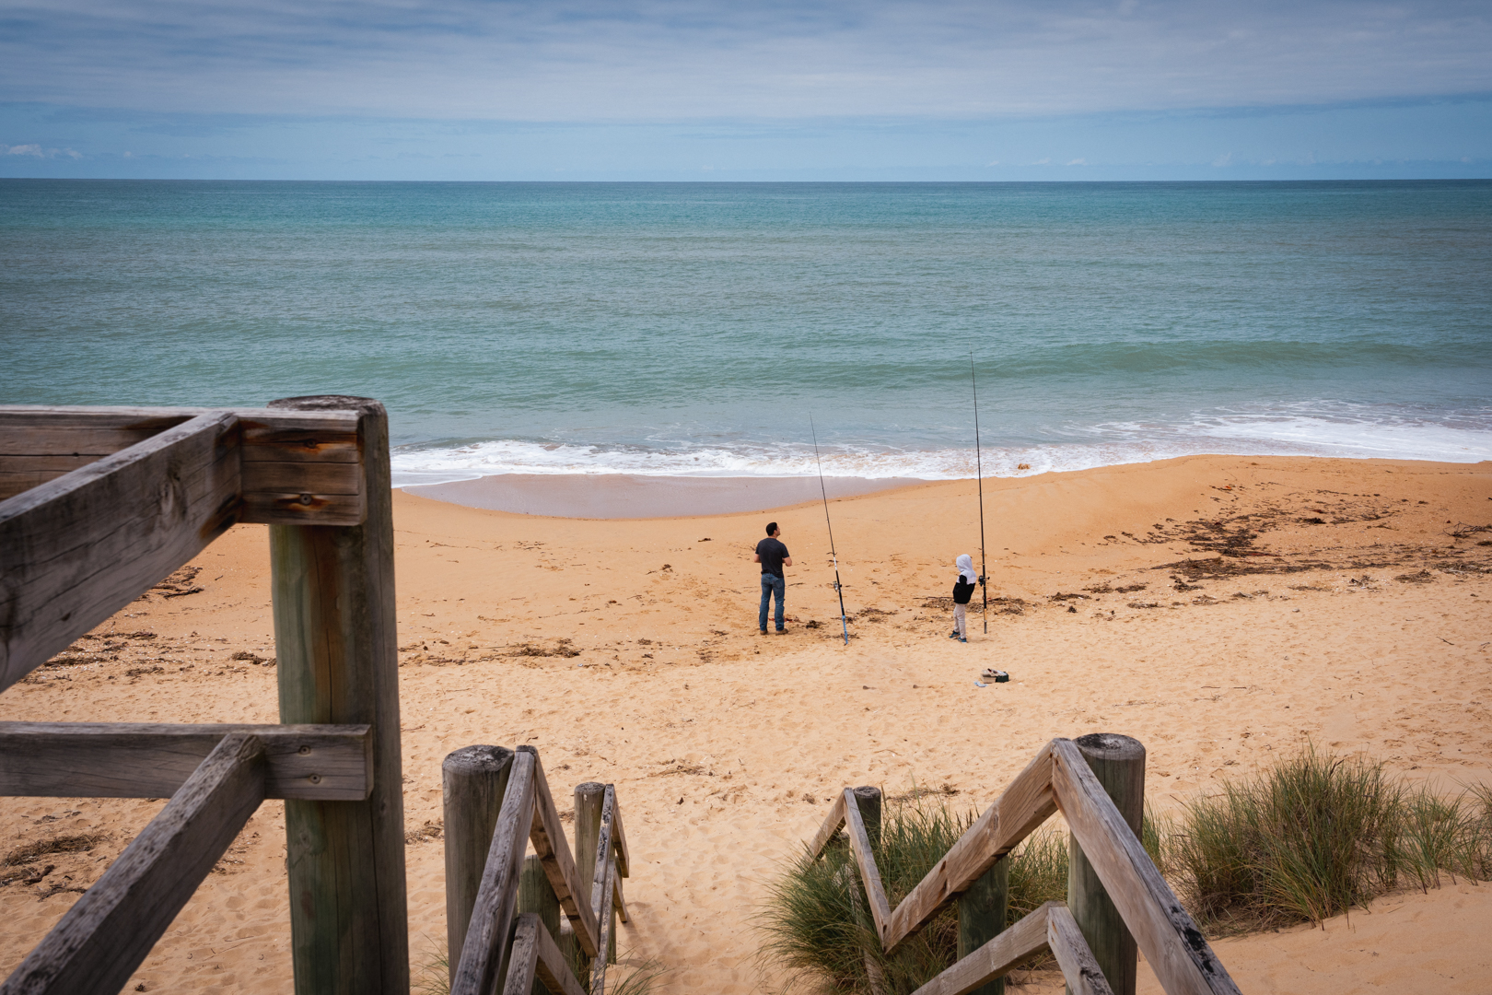
Beach Fishing
HC
Lily Bernau
A nice family shot here – a man and his son enjoying a day fishing at the beach pretending they’re going to catch something. The stairs lead our eyes into their day and the colours of sea, sun and clouds complement each other. The various elements are nicely proportioned and it’s a nice portrait of what life is all about.
Open Gippsland-Novice-150-Beach Fishing.jpg
11 / 15

Slide 4
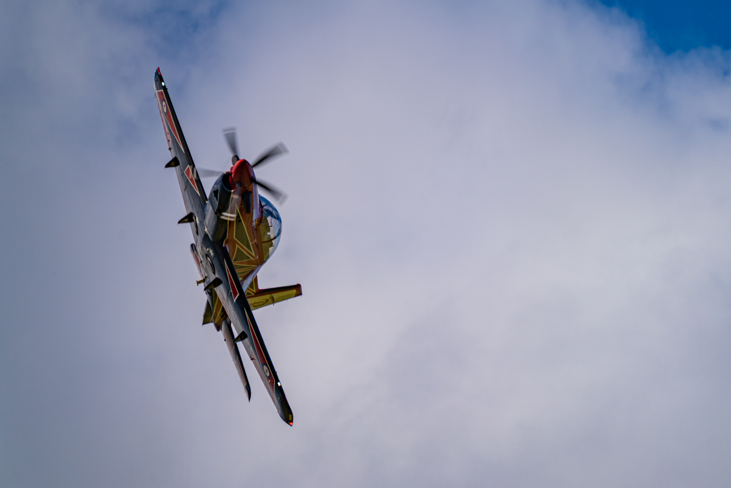
PC21
Third
Robert Johnson
A difficult shot to manage given the distance, lighting etc but it’s been well handled. Plenty of detail and the plane is nicely placed within the frame leaving room to travel. I would suggest rotating the image so that the plane’s wings are at more of a 45 degree angle, which is where the viewing audience’s heads will be when they view this one. There is a bit of a tendency to adjust one’s viewing angle to take in the detail and overall I think that small change would improve what is already a good image.
Open Gippsland-Novice-149-PC21.jpg
12 / 15

Slide 5
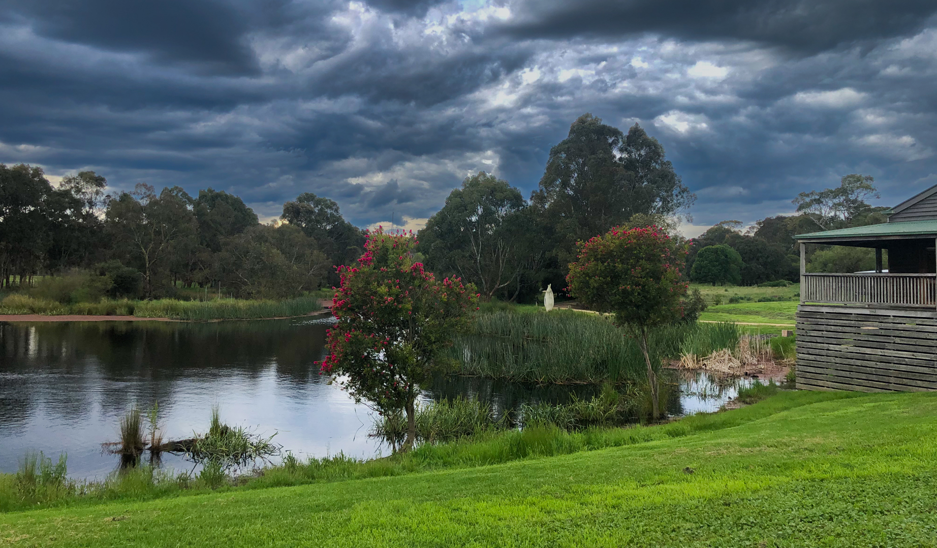
HeyfieldWetlands
Second
Marg Gwyther
Another dramatic composition with lighting that works really well to convey an atmosphere of impending storm. Lots of interest here in a nice composition. I would crop it very slightly to remove that bright spot in the water (left of image) and I’d also take the saturation down a notch, particularly the green grass, but it is a very nice image.
Open Gippsland-Novice-145-HeyfieldWetlands.jpg
14 / 15

Slide 6
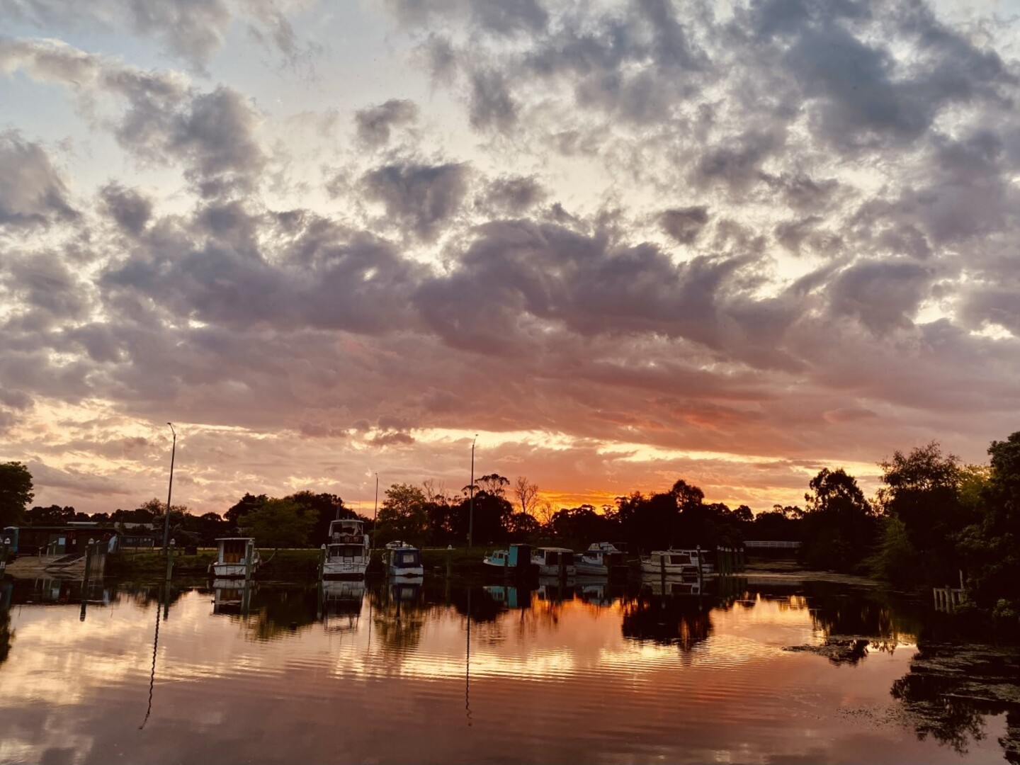
Sail Away
Hayley Furlong
An interesting cloud formation and lighting that has great potential. There is a lot more colour to be brought out here, and with some selective changes you will find that this image can become much richer. There are various ways of approaching this image including cropping out the top portion of the sky and applying selective changes to the central area which is largely in darkness. A good one to work on but in need of a bit of post processing.
Open Gippsland-Novice-148-Sail Away.jpg
11 / 15

Slide 7
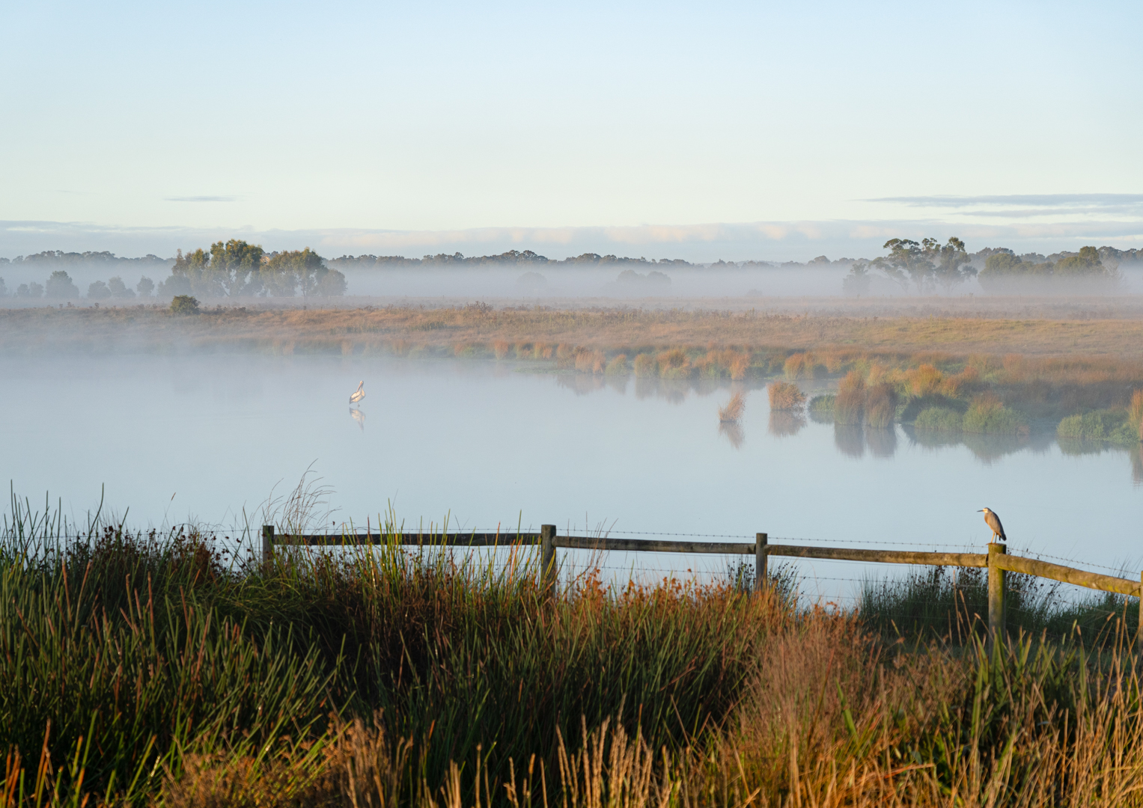
Morning Mist
Lily Bernau
I sometimes imagine these scenes but rarely capture them due to my preference for staying in bed. However, for photographers who do manage it, this is one of the rewards. Great misty morning shot with nothing to disturb the tranquillity. The perfectly still waters and two birds complete the scene. The overall image is one of two distinct parts. The foreground is quite dominant and demands our attention, while the upper half of the image is less demanding which lets our eye return to the foreground. It would be worth experimenting by altering that balance using different cropping or by trying graduated filters in your processing software to balance the two halves of the image.
Open Gippsland-Novice-150-Morning Mist.jpg
0 / 15

Slide 8
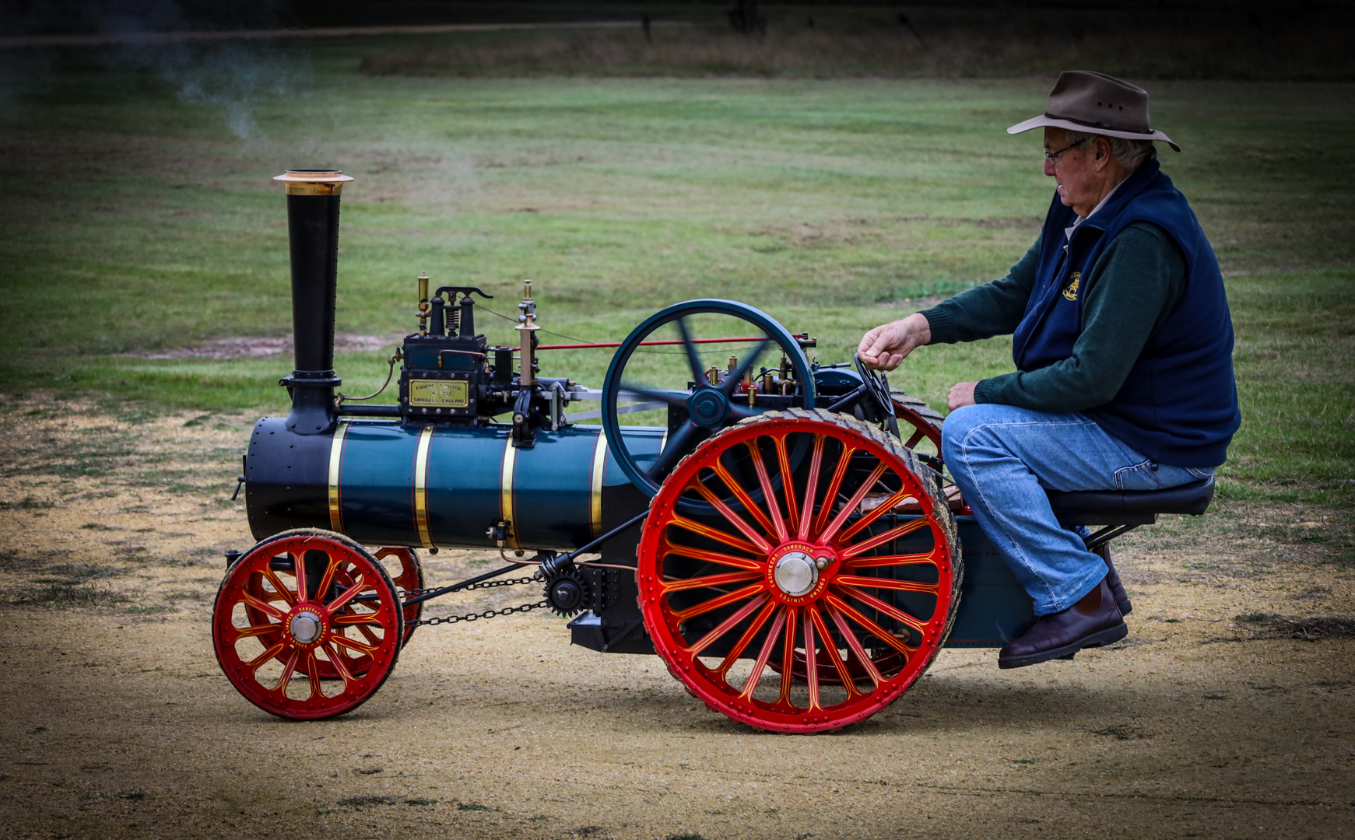
SteamingFun
First
Marg Gwyther
Love this one, if nothing else for the bright colours and sharpness. It is a striking image and one which grabs our attention encouraging us to linger longer. The only downside is the rather overdone vignette which tends to distract us from the main game. A little vignette is great, but be wary of overdoing it.
Open Gippsland-Novice-145-SteamingFun.jpg
15 / 15

Slide 9
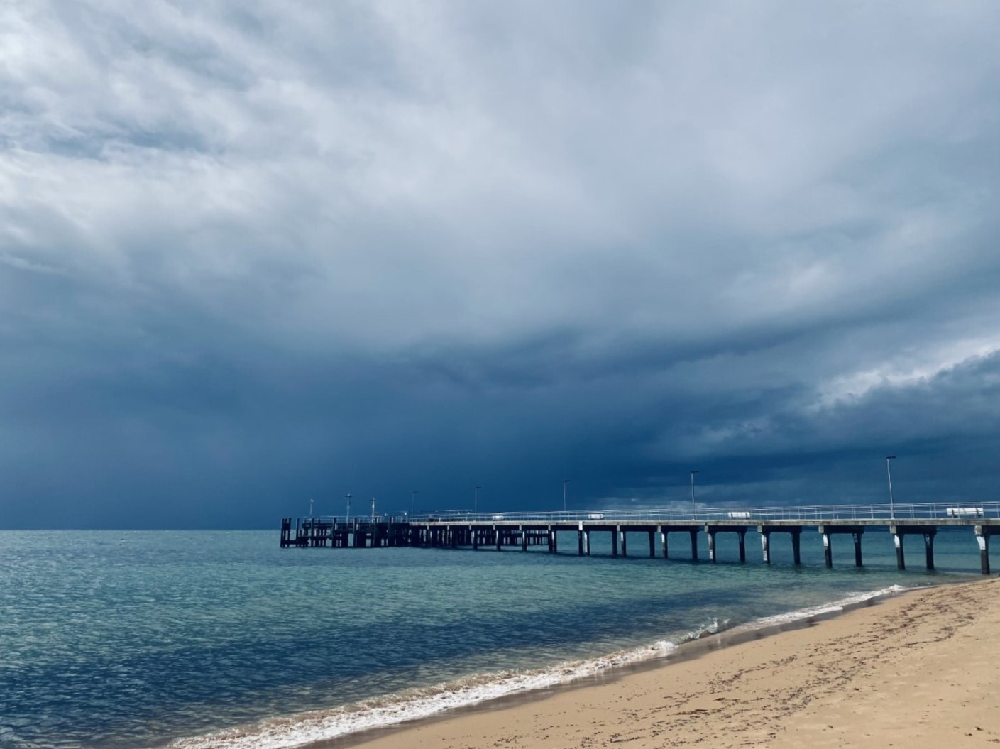
Stormy Jetty
Hayley Furlong
An impressive storm cloud gives interest and impact to this image. The sky dominates the land and sea and puts our own feeble size and strength into perspective. The total absence of people contributes to that overall atmosphere very well. My only suggestion would be to change the white balance. Moving your WB slider back and forth can make huge differences to the overall feel of the moment and I found that this easy change softened the bluish cast and produced a much better image. It’s a useful way of improving many images, and so easy it only takes a second.
Open Gippsland-Novice-148-Stormy Jetty.jpg
13 / 15

Slide 10
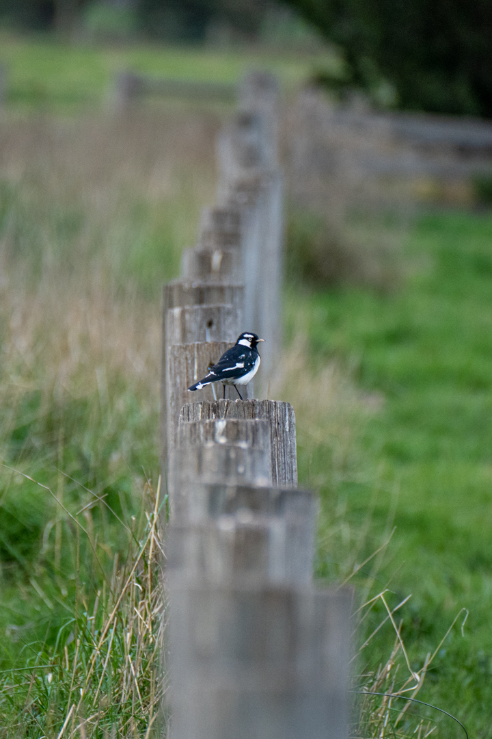
Keeping Watch
Lily Bernau
The selective focus provides a very shallow depth of field here. It focusses our attention nicely and makes the bird the primary focus. The bird himself is rather small, and doesn’t command as much attention as if it had either been a bigger bird or more tightly cropped. Although you would lose some background interest, I think a more tightly cropped image would overcome that issue and produce a more engaging image.
Open Gippsland-Novice-150-Keeping Watch.jpg
11 / 15

Slide 11
Winners
Place | Photographer | Image
First | Marg Gwyther | Steaming Fun
Second | Marg Gwyther | Heyfield Wetlands
Third | Rob Johnson | PC21
HC | Lily Bernau | Beach Fishing

Slide 12
Sale Camera Club
February 2023
Open Class
Open Gippsland
Judge Bob Thomas

Slide 13
Raindrops on Roses
Sherrol Gibson
Water droplets on flowers is always a good recipe, and it works well here. Pleasant colours and sharp where it counts. There is an odd white imperfection in the left hand third which is distracting and needs to be cloned out. Maybe that was just in my copy …. not too sure. In any event it is a very pleasant image cropped well to good effect.
Open Gippsland-Open-108- Raindrops on Roses.jpg
10 / 15

Slide 14
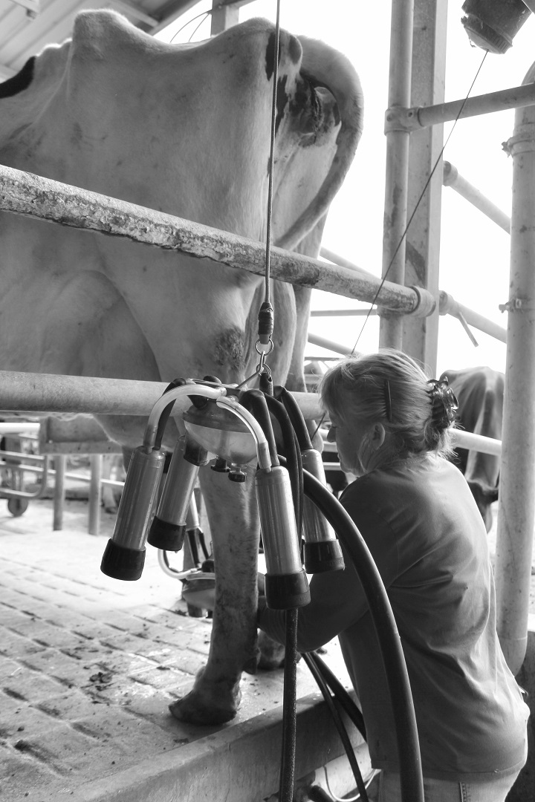
Last Cups
Lauren Reilly
I’d be looking for an umbrella as standard equipment if I had this job! This has to be an Occupational Health and Safety issue. The monochrome treatment is probably appropriate given that there’s possibly not a lot of colour anyway. It does illustrate an aspect of working life on a farm although a different angle might have shown more of what the woman is doing. Seeing her hands would have helped here as it would have given more insight to the overall story. Taking it from the right might also have cut out some of the sky which is a little overpowering. Good idea though with great potential if you can re-visit it.
Open Gippsland-Open-126-Last Cups.JPG
9 / 15

Slide 15
Midnight Bloom
Leanne Peck
A novel approach here, and quite striking. The monochromatic treatment works well and the flower is well isolated. Perhaps a little more in the way of supportive elements might have lifted it a bit as despite the impact it is also a little stark. It would be interesting to see the colour version to compare the impact of each.
Open Gippsland-Open-32-Midnight Bloom.jpg
12 / 15

Slide 16
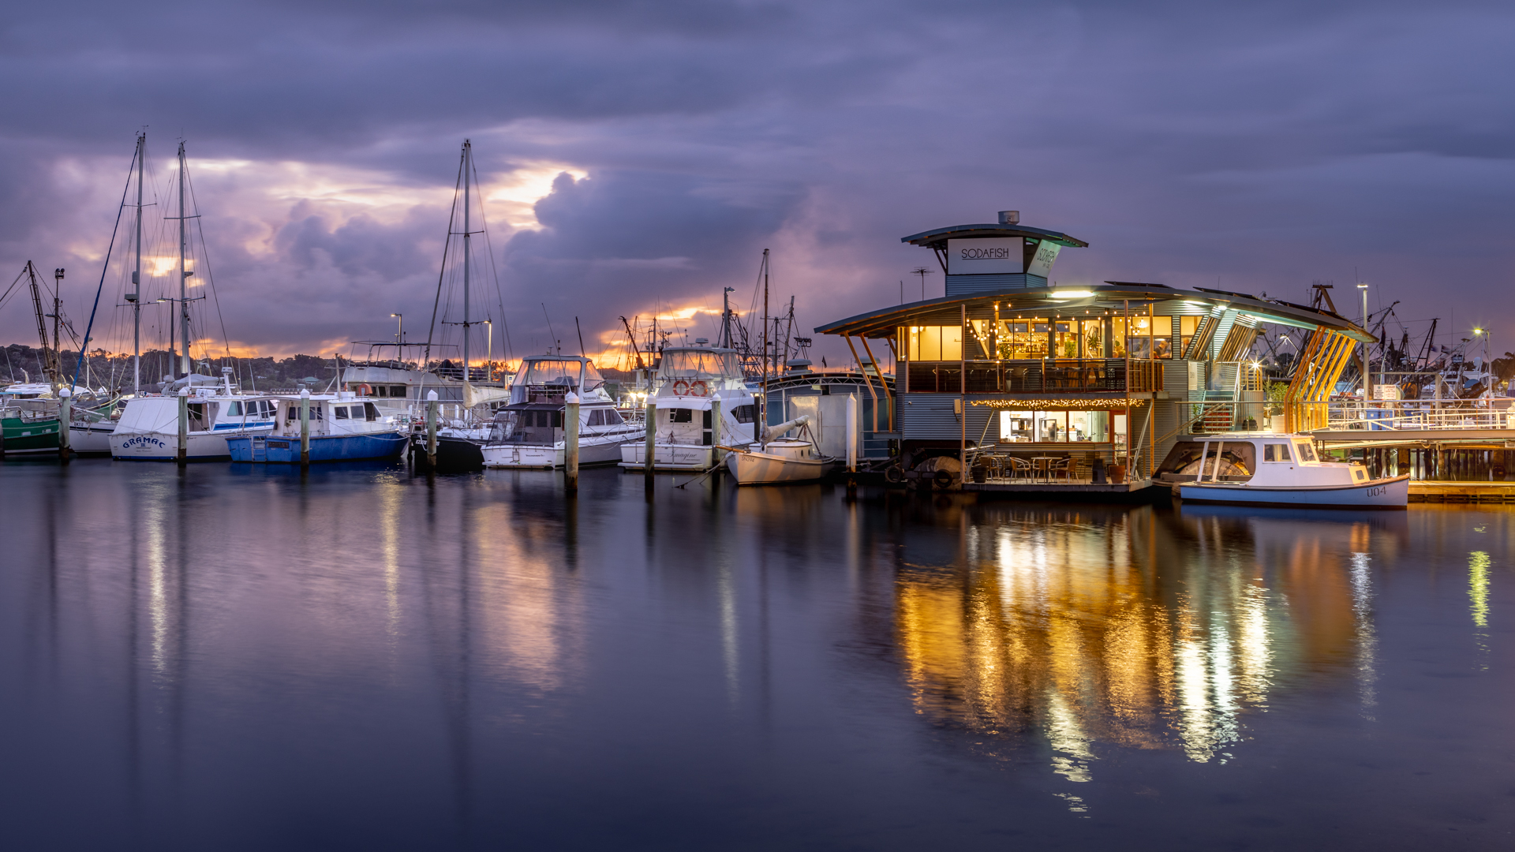
Lakes Entrance Storm Approaching
Merit
Lotje McDonald
Love the lighting on this one. Our attention is drawn to the main building which is captured in sufficient detail to see inside, providing interest to the image. The reflections and overall tonality blend well to produce an interesting waterfront scene.
Open Gippsland-Open-36-Lakes Entrance Storm Approaching.jpg
14 / 15

Slide 17
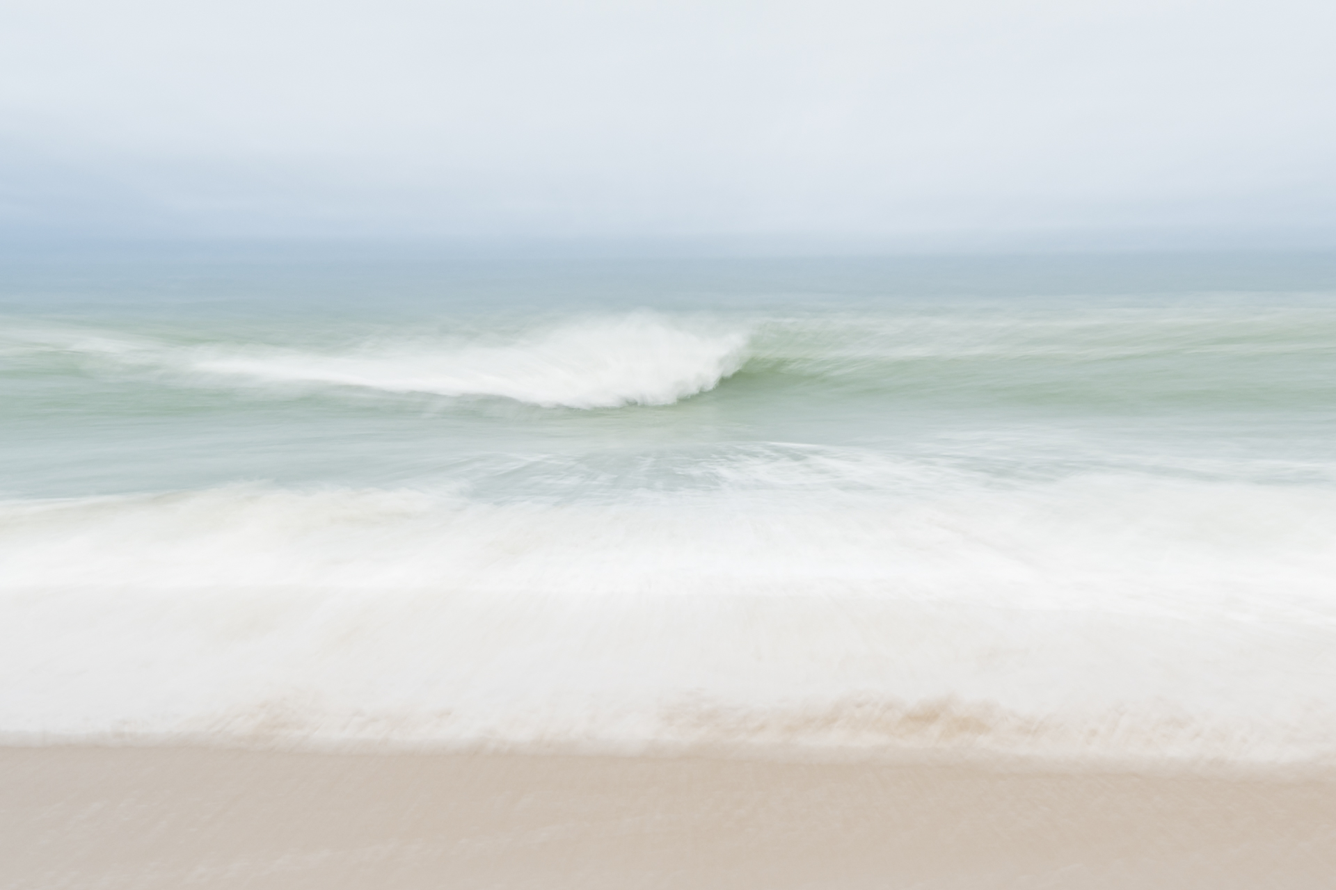
Ocean Views
HC
Leanne Peck
This is really very pleasant, and turns an average piece of ocean into an engaging work of art. The diffused treatment blends the elements of sea and sky really well. One can imagine the straight shot prior to being processed and it would have given the viewer little of interest in comparison with this re-worked version. Our eyes are drawn into the center of the image and it is one of those images which makes us linger longer.
Open Gippsland-Open-32-Ocean Views.jpg
15 / 15

Slide 18
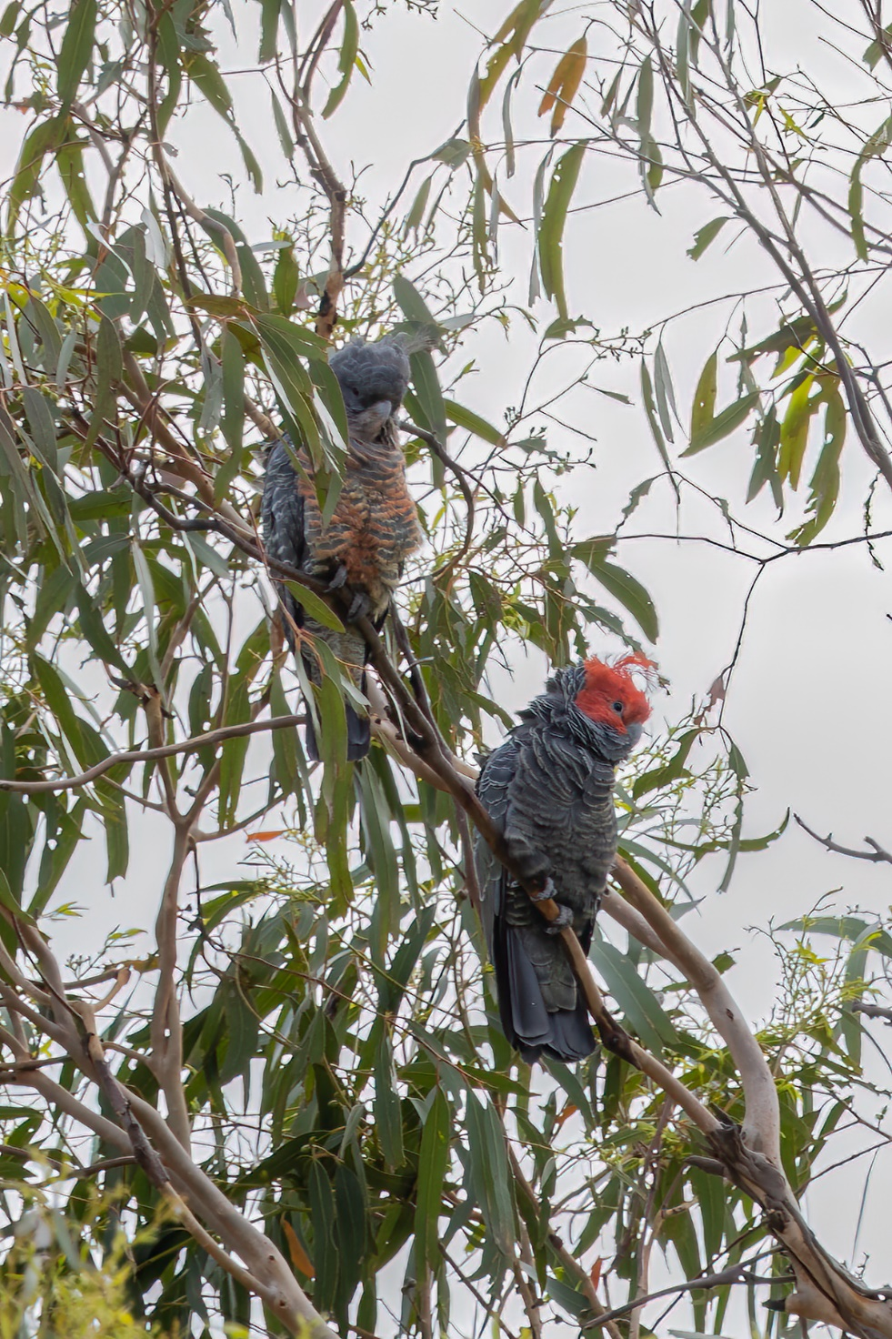
Chillin'
Tania Knight
Always difficult to photograph birds against the sky, but not easy to obtain a better position to reduce the impact on your exposure. You’ve done well to capture this couple under the circumstances, but you may be better off seeking ways of concentrating our attention on the birds rather than their environment. Using a long lens would help or perhaps cropping the image more tightly to remove that background and concentrate on the detail in the bird’s feathers.
Open Gippsland-Open-41-Chillin'.jpg
13 / 15

Slide 19
Blooming Tears
Sherrol Gibson
Another flower with droplets, presented as a mono image. It is well presented although the front petal is a little out of focus. Where the viewer’s eyes are directed to such a specific targeted zone of an image it is important that the targeted area is universally sharp. In this instance, maintaining a shallow depth of field is unnecessary due to the fact that there is no background to diffuse. The isolation of the subject has been achieved by removing the background altogether. In this scenario you could aim for greater DOF so as to have the whole flower in focus.
Open Gippsland-Open-108-Blooming Tears.jpg
10 / 15

Slide 20
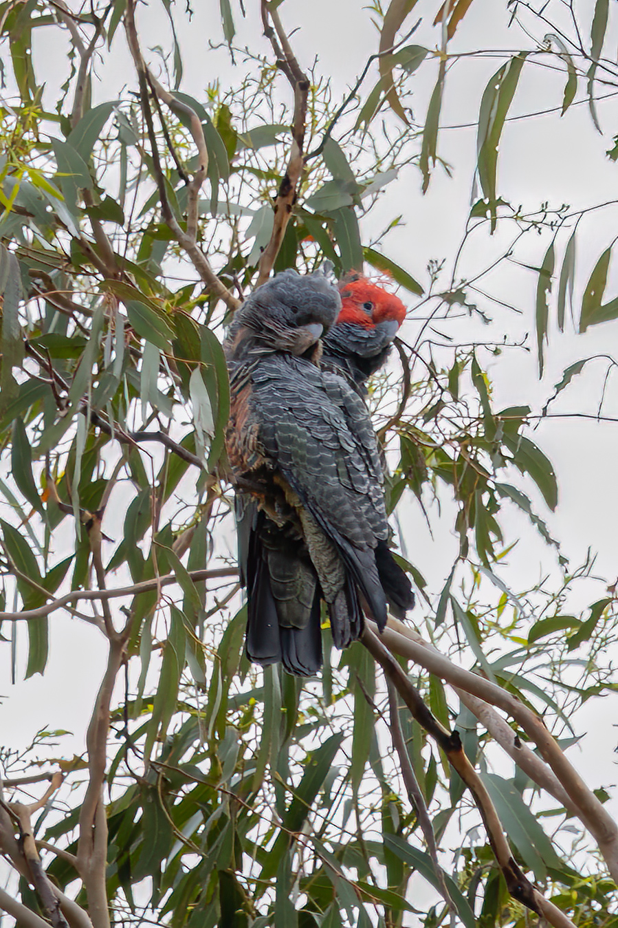
Lovers
Tania Knight
A very similar image to one posted earlier, but probably a better take on the same subject. Again, a closer crop would prove beneficial here and produce a better image with fewer distractions. As a general principle, it’s not a good idea to enter two near identical images in the one competition. Far better to spread your choices between totally different images so that various ideas can be explored, giving yourself a higher chance of winning.
Open Gippsland-Open-41-Lovers.jpg
9 / 15

Slide 21
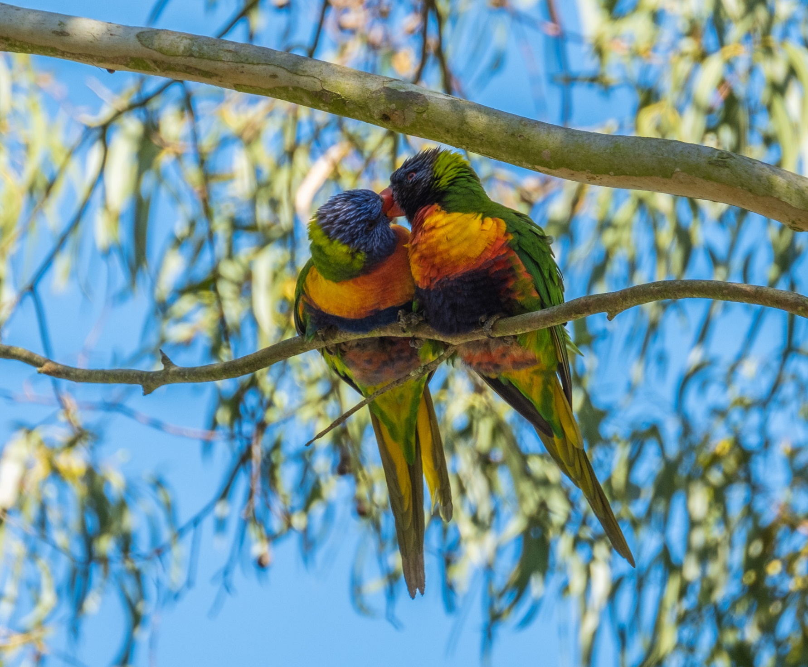
Lovers
Ross Stothers
A romantic interlude captured well. Pressing the shutter at exactly the right time requires either skill or a motor drive, but whatever method you used has achieved the desired outcome. I feel the image is a little over-saturated and might be improved by reducing the blues a little. This would move our gaze more to the birds rather than being a little overwhelmed by so much blue sky.
Open Gippsland-Open-99-Lovers.jpg
10 / 15

Slide 22
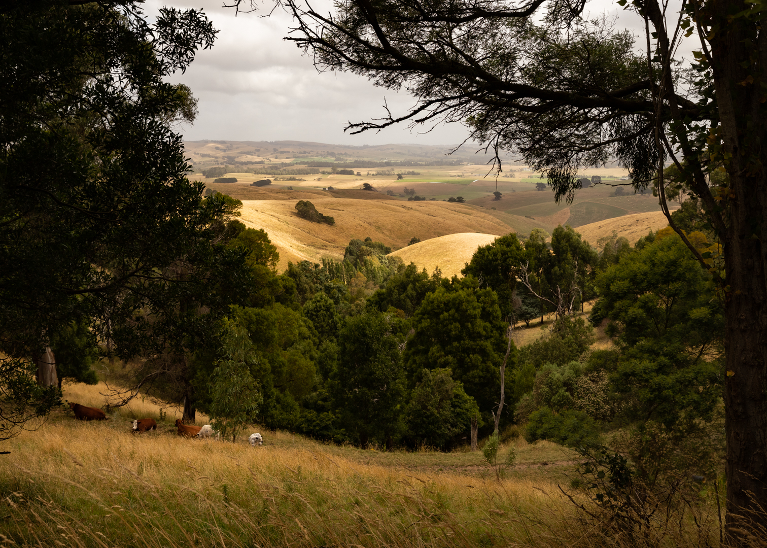
South Gippy Farmland
HC
Adele Bronts
This really captures a nice slice of the Gippsland countryside. There are various elements of country life presented here which, to a city dweller, represents such a welcome change from the barren metropolitan landscape. The image is nicely framed by the trees and our eyes are lead into the rolling hills, past the cattle and through to the horizon beyond. There is a lot to maintain the viewer’s interest. A slight increase in the peripheral exposure might help it a bit, but overall a very nice image.
Open Gippsland-Open-89-South Gippy Farmland.jpg
12 / 15

Slide 23
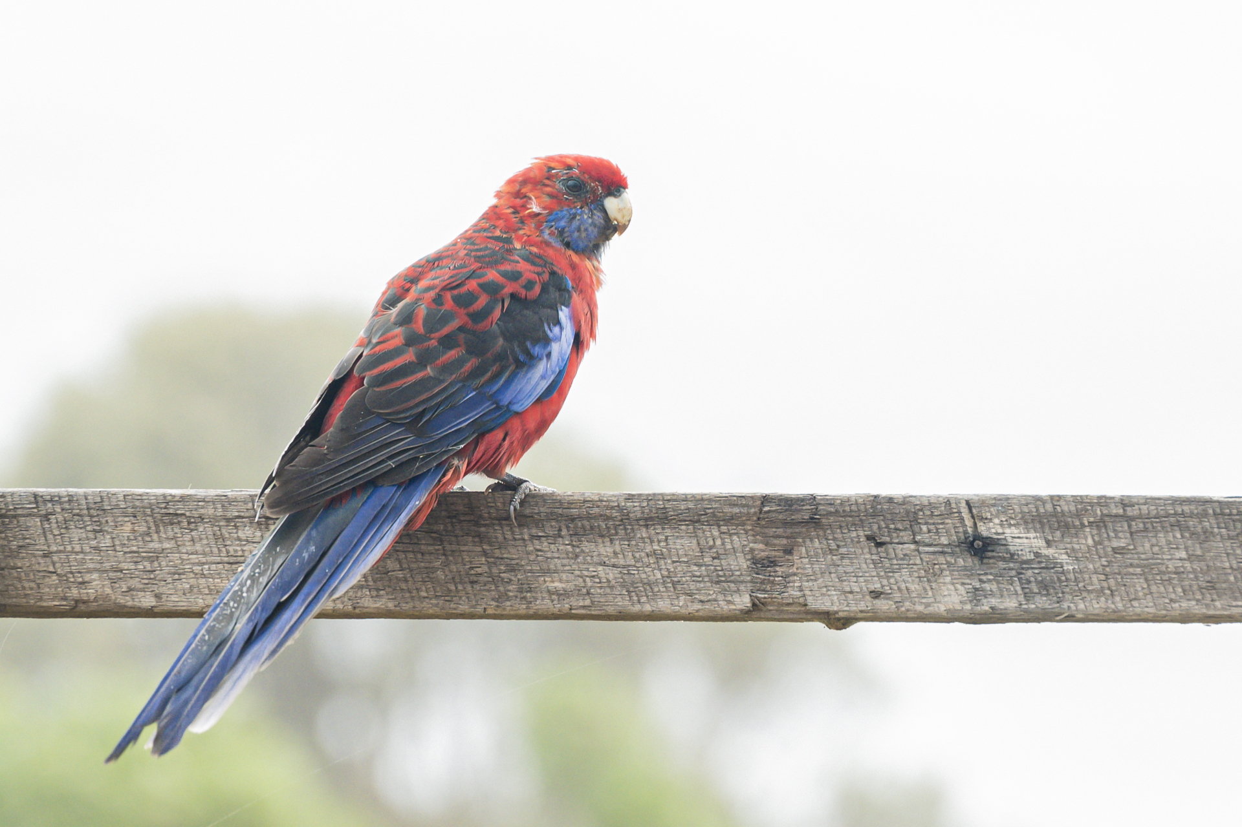
Crimson Rosella
Leanne Peck
Nicely isolated from his surroundings and facing in the right direction, this captures the Rosella well. The bird is well placed in the frame and the image is sharp. On the one hand you have focussed our attention on the subject, but on the other hand there isn’t a lot in the way of a supportive environment. Perhaps a little more context and maybe a little more saturation and contrast might have helped this to become a more striking image.
Open Gippsland-Open-32-Crimson Rosella.jpg
10 / 15

Slide 24
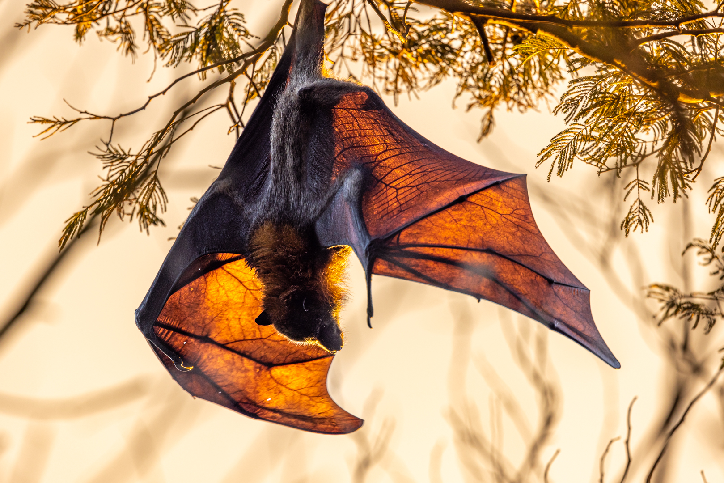
Sunset Stretch
Second
Lotje McDonald
The lighting here is quite special as it lets the viewer see the structure of the wings as well as the shape and form. The background provides a useful but not dominant canvas and the foliage frames the bat well. A well exposed and interesting image. There is a slight aberration on the RH wing (our right) which could be rectified with a bit of judicious post processing.
Open Gippsland-Open-36-Sunset Stretch.jpg
9 / 15

Slide 25
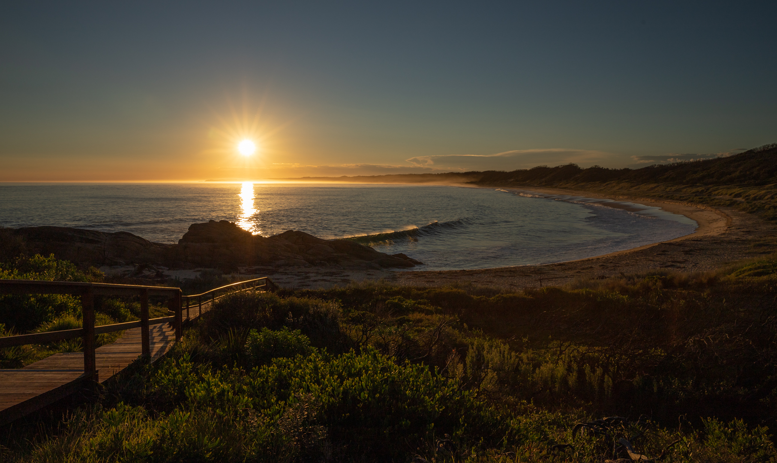
Sunset at Salmon Beach
Third
Adele Bronts
One of the advantages of sunsets over sunrises is the fact that you don’t have to get out of bed so early, and this shot illustrates how sunsets can be just as pleasant without the sleep deprivation. I like the sun’s rays here and the fact that although the sun draws our eyes it does not overly dominate the composition. The pathway to the left and the beach to our right lead us inward and through the image. The breaking wave and the sea spray add just a touch of movement in an otherwise tranquil scene.
Open Gippsland-Open-89-Sunset at Salmon Beach.jpg
13 / 15

Slide 26
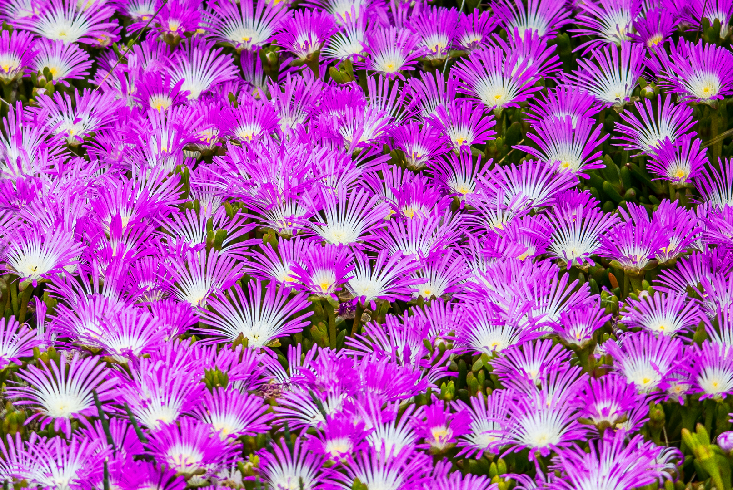
Big Dog Island
John Gwyther
The image has an immediate impact and an “in your face” approach which captures the viewer’s attention. The colours are great and the images is sharp as a tack. I would tend to crop off the right-hand side so as to remove the odd spaces without flowers. Part of the appeal is the concentration of flowers so continuing that across the whole image might prove beneficial. Nice image.
Open Gippsland-Open-94-Big Dog Island.jpg
10 / 15

Slide 27
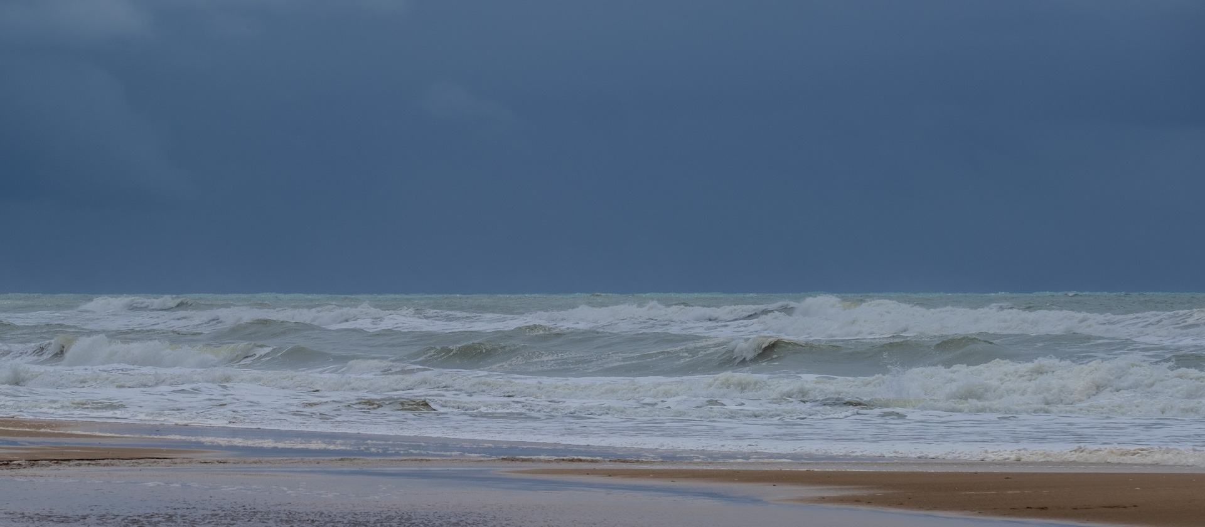
Seaspray
Ross Stothers
Lovely colour palate here, with our attention focussed on the waves. It makes for a relaxing and inviting shot of nature and the relentless sea. Hard to recommend any changes here. It’s possible that a ship on the horizon or a couple of seabirds might make a difference, but it’s equally possible that those things might take away from the serenity of the scene. Compositionally it is a pleasing image but perhaps needs something more such as a piece of driftwood on the sand just to give it that missing element.
Open Gippsland-Open-99-Seaspray.jpg
10 / 15

Slide 28
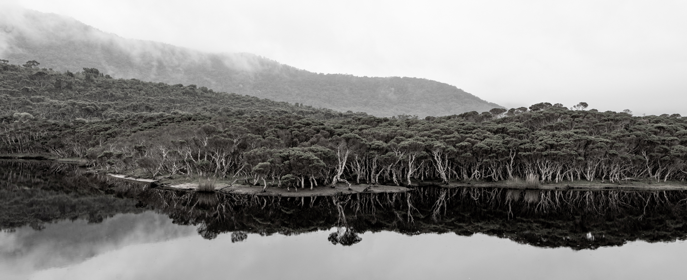
Dancing Trees
First
Lotje McDonald
This is a great shot. Not simply a representation of a slice of the landscape but much more than that. It is a stunningly beautiful capture which isn’t just a keeper – it’s a wall hanger. The white bark of the tree trunks adds an artistic element which really lift this image, supported as well by the reflections in the water. The subdued toning and the mist in the background add to the overall appeal. I found that a graduated filter along the top brings out a little more detail and makes it even better, but overall this is a really nice image and one to be proud of.
Open Gippsland-Open-36-Dancing Trees.jpg
11 / 15

Slide 29
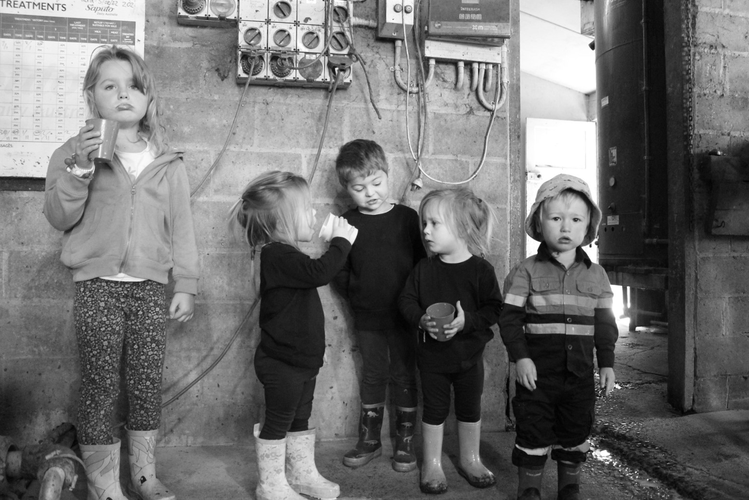
Last Drinks at Pa's Dairy
Lauren Reilly
This has the potential to be a really good shot, but to achieve that you probably need to offend the girl on the left by cropping her out completely. The main image and story lies within the group of four children, and cropping tightly on to that group will give you a great image. It would cut out all the peripheral distractions and allow the various facial expressions to dominate. The expression on the boy at the right is priceless! Well worth re-visiting this image and then re-entering it. As it stands it is perhaps a little busy.
Open Gippsland-Open-126-Last Drinks at Pa's Dairy.JPG
10 / 15

Slide 30
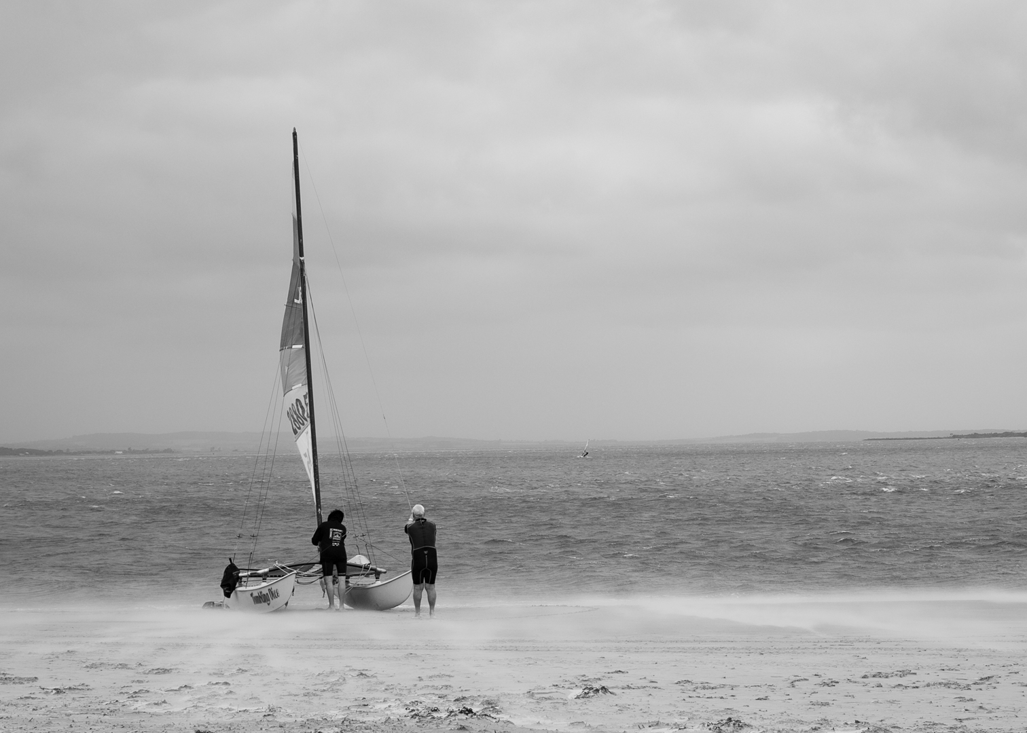
Tumbling Dice
Adele Bronts
The monochrome treatment works quite well here and the offset position of the boat also creates a good composition. It might have been handy if the distant windsurfer had been allowed to come a little closer to provide more interest and better balance, but it’s a nice image.
Open Gippsland-Open-89-Tumbling Dice.jpg
10 / 15

Slide 31
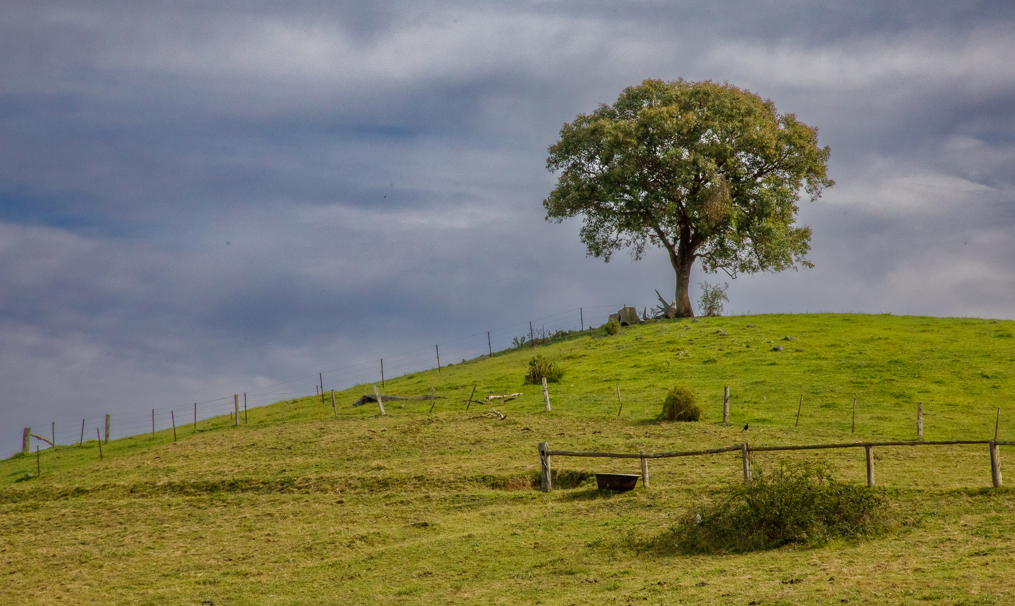
Coongulla
Merit
John Gwyther
Always appealing to have the lone tree standing on a hilltop. It’s a familiar theme but always interesting nonetheless. The sky is well toned and with sufficient detail to add interest rather than being a bland expanse. The detail is great with enough things to look at without being cluttered. A nice representation of country Victoria.
Open Gippsland-Open-94-Coongulla.jpg
11 / 15

Slide 32
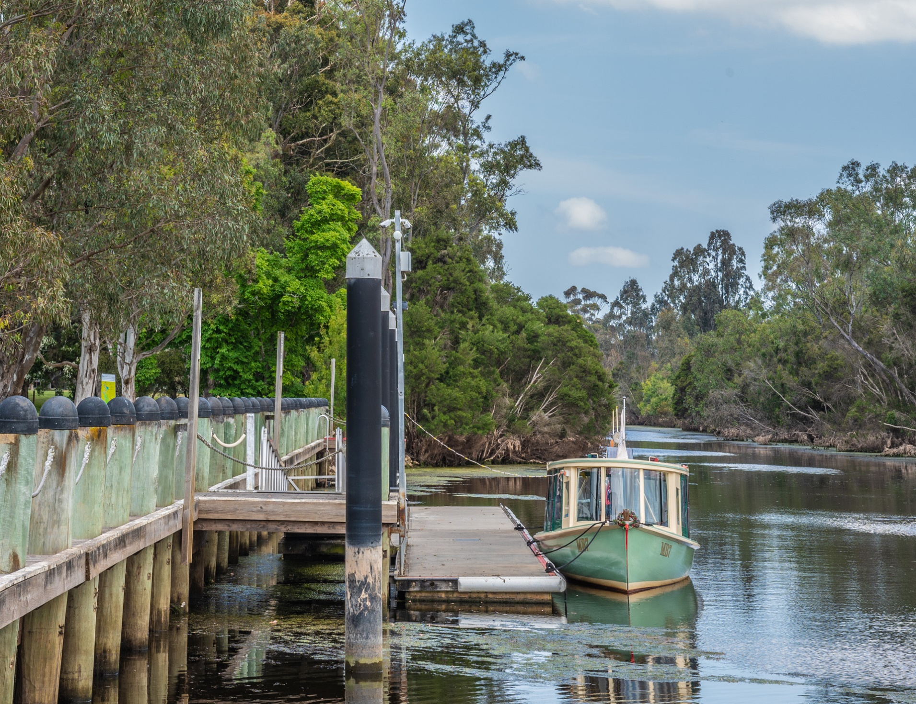
Port of Sale
Ross Stothers
Rivers and watercourse generally make good subjects. The exposure here is good and the image is sharp and detailed. I’m inclined to think that the image isn’t helped by the various posts along the left half. I would crop out almost half the image plus a quarter of the sky, leaving you with a really nice squarish format picture of the boat, landing and river. That’s where the real image lies, and it would greatly improve the entry and lift it into a much higher position.
Open Gippsland-Open-99-Port of Sale..jpg
10 / 15

Slide 33
Winners
Place | Photographer | Image
First | Lotje McDonald | Dancing Trees
Second | Lotje McDonald | Sunset Stretch
Third | Adele Bronts | Sunset At Salmon Beach
Merit | Lotje McDonald | Lakes Entrance Storm Approaching
 | John Gwyther | Coongulla
HC | Leanne Peck | Ocean Views
 | Adele Bronts | South Gippy Farmland

